Slide 1




Boeing Cabin Experience Team 11
Win Todd, Cole Donovan, Nicholas Mooney, Paige Webber

Slide 2

z
Proprietary Disclosure

Slide 3



Slide 4
Flight Test Application (FTA) that can be ran in real time
Desired logs were not located in one central location
Desired logs cannot be accessed away from aircraft

Slide 5

REQUIREMENTS
Access to data while test flight is in air

Slide 6
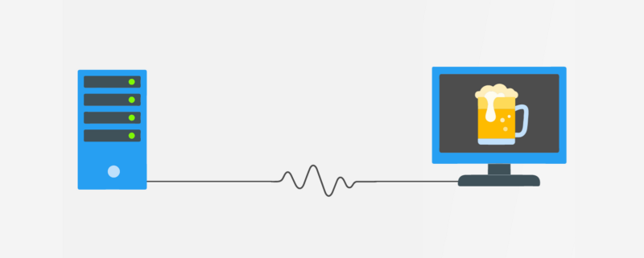
Health Status Service
Report Handler Service
Connected Devices Service
IPA?
No, an API!

Slide 7
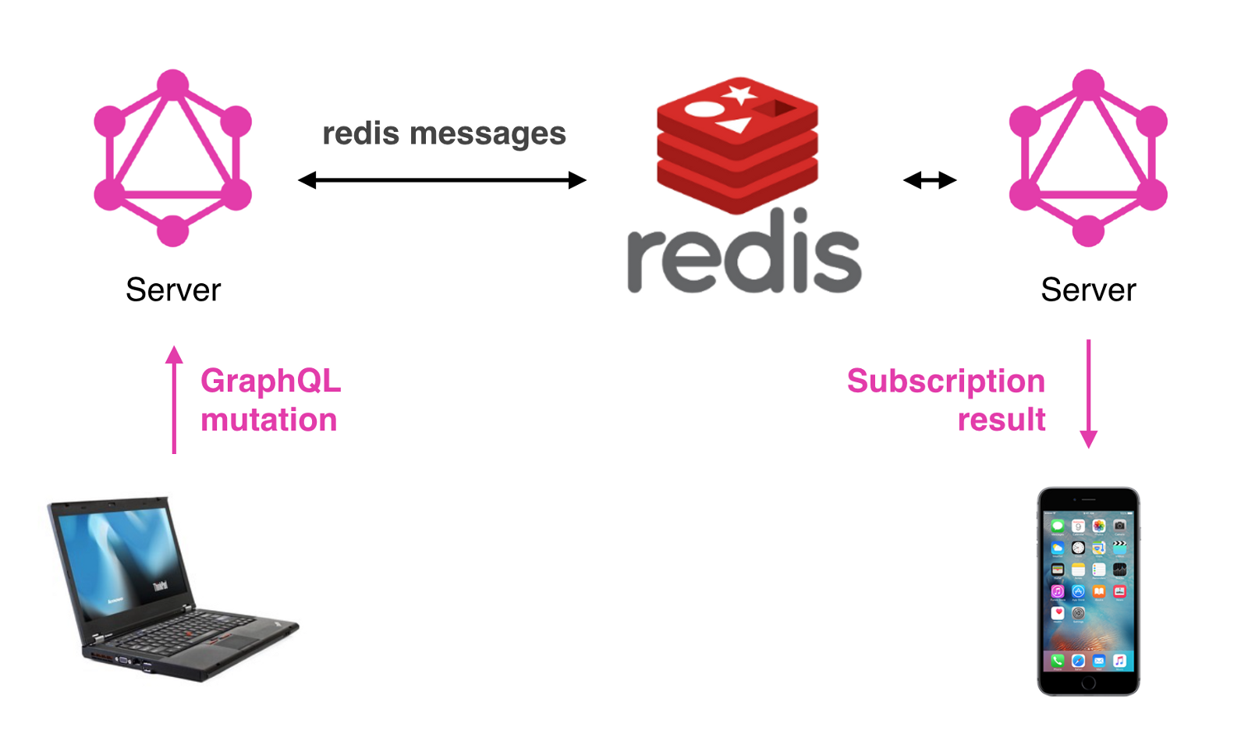

Slide 8
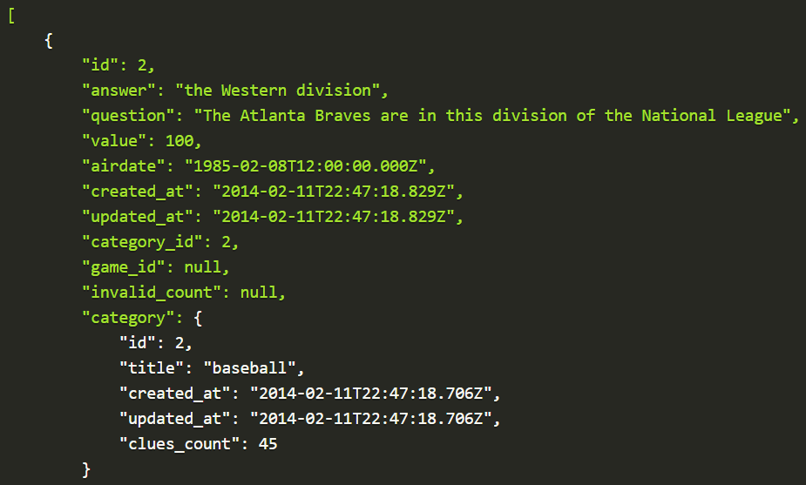

Slide 9
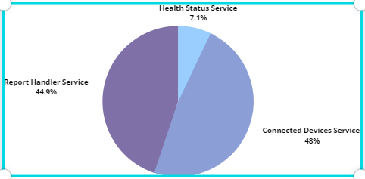
z
127 Endpoints! 183 Schemas!
Number of GET Endpoints: 69
Number of POST Endpoints: 58

Slide 10
DELIVERABLES
Service Simulator Application (SSA)
Flight Test Application (FTA)
API documentation

Slide 11
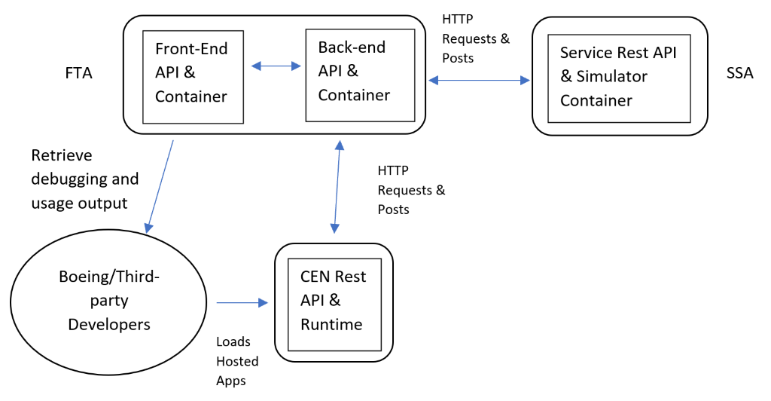
SOLUTION

Slide 12
WORK ACCOMPLISHED

Slide 13
The SSA

Slide 14

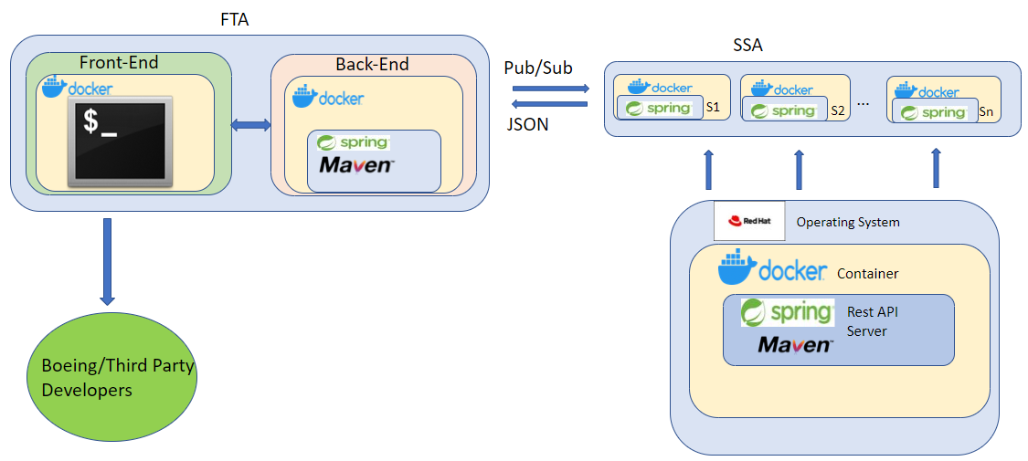
WORK PROCESS
z
Create a server with java spring boot that will be able to generate data necessary for the flight test application
Return this data to a client in the same API format as normal Boeing software.
Use Docker containers to efficiently deploy software.

Slide 15

DEMO TIME
z

Slide 16


Slide 17
MILESTONES
Demoable Milestones | Description​
JSON Server Responses​ | Simple API sever that is dockerized and can be invoked to generate data and return in Json
Conforms to Boeing API | Conforms to same Data and API as Airplane Info Systems​
SSA Completion | Mimics data the airplane Info system provides​ and is configurable and documented
Displays Troubleshooting Logs​ | Visibly formats logs from the server for debugging​
Parsing Troubleshooting​ Logs​ | Able to search for specific logs by type or time​
Error Processing​ | Accept and publishes errors to the user based on logs​
Configuration Settings​ | Able to change and view settings for SSA and FTA as well as installed software​

Slide 18
SPRINT DETAILS
Sprint | Sprint Goal
Sprint 1 | Develop designs, establish baseline understanding for API design, build foundation for SSA response
Sprint 2 | Populate several dockerizable service simulators within the SSA
Sprint 3 | Finalize SSA with proper PubSub modeling that accounts for future pathing of possible configuration of data generation
Sprint 4 | Develop a backend that display logs in Realtime and can alternate between each service as well as keep track of all received logs for parsing later

Slide 19
NEW SPRINT DETAILS
Sprint | Sprint Goal
Sprint 1 | Develop designs, establish baseline understanding for API design, build foundation for SSA response
Sprint 2 | Populate several dockerizable service simulators within the SSA
Sprint 3 | Finalize SSA with proper PubSub modeling that accounts for future pathing of possible configuration of data generation
Sprint 3.5 | Finalize accurate data modeling across all endpoints with proper documentation as well as save consistency
Sprint 4 | Develop a backend that display logs in Realtime and can alternate between each service as well as keep track of all received logs for parsing later

Slide 20

RISKS
Technical/Computer
Incomplete access to Boeing documentation and information
Unable to meet the scope

Slide 21
ADDITIONAL CONSIDERATIONS
Scheduled more meetings
Reformat modeling to conform to a pub/sub system

Slide 22

QUESTIONS
z

